Slide 1

CARVANA
Minimize Budget Margin, Increase Profitability
Data Exploration
Anne, Yogesh, Stanley, Rui

Slide 2

Assumptions/Definitions
MMRAcquisitionAuctionAveragePrice = Budgeted cost price
MMRCurrentRetailAveragePrice = “Actual” selling price
VehBCost = Actual cost price including cost incurred to bring the inventory to sales condition and location necessary for sale.
No other cost incurred asides VehBCost
Profit Margin = (Sales Price - Cost Price)/ Sales Price
Budget Variance Margin = (VehBCost - MMRAAAP)/MMRAAAP

Slide 3
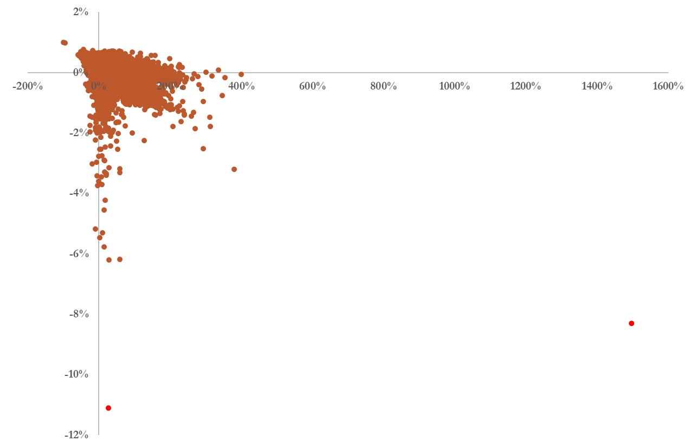
Relationship (BM vs PM)
Budget Margin
Profit Margin

Slide 4
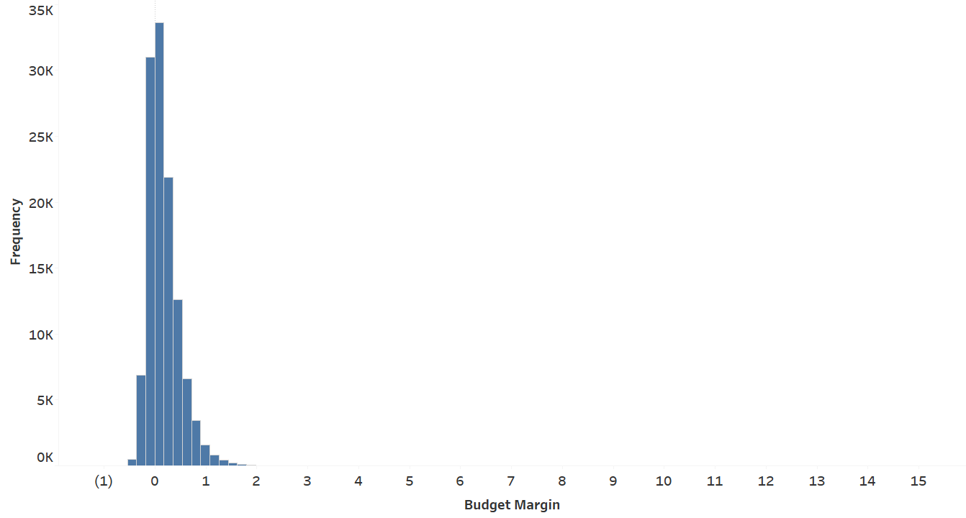
Budget Margin Distribution
“Conservative” Approach
A threshold was defined at the 95th percentile (0.75) to divide the data into two categories:
<=0.75: Low Variance Margin
>0.75: High Variance Margin

Slide 5
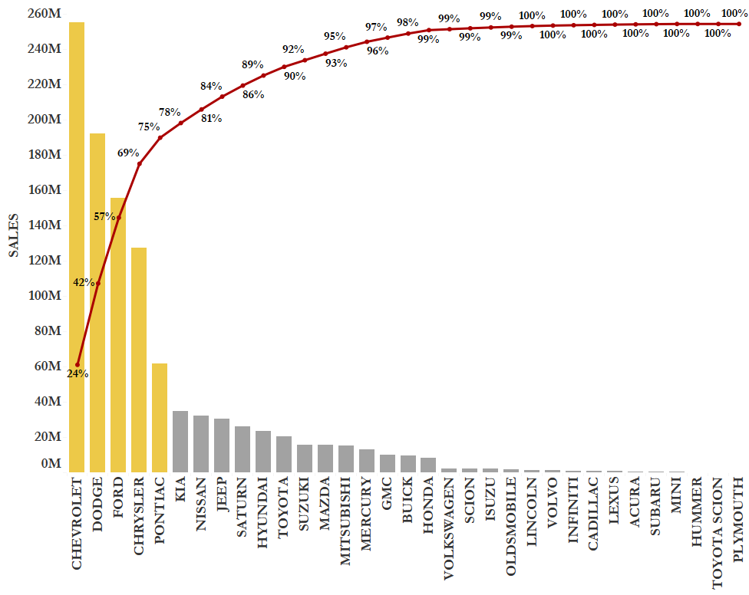
Top 5 Car Make (% Sales Rev)

Slide 6
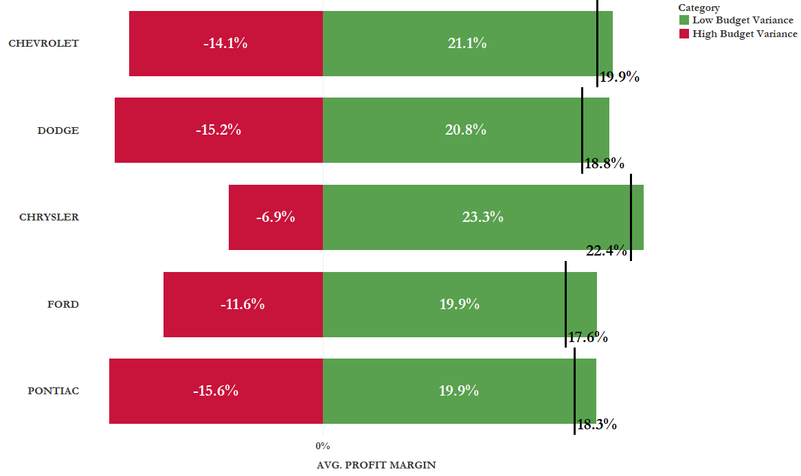
Average Profit Margin
Takeaway:
Average profit margin for high budget variance is Negative

Slide 7
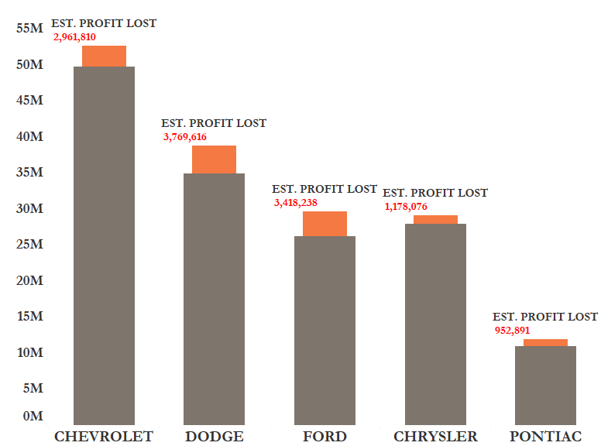
Impact of Unfavorable High BM On Profit
Unfavorable variance should ALERT management that the company's profit will be less than expected.
The sooner an unfavorable variance is detected, the sooner attention can be directed towards fixing any problems

Slide 8
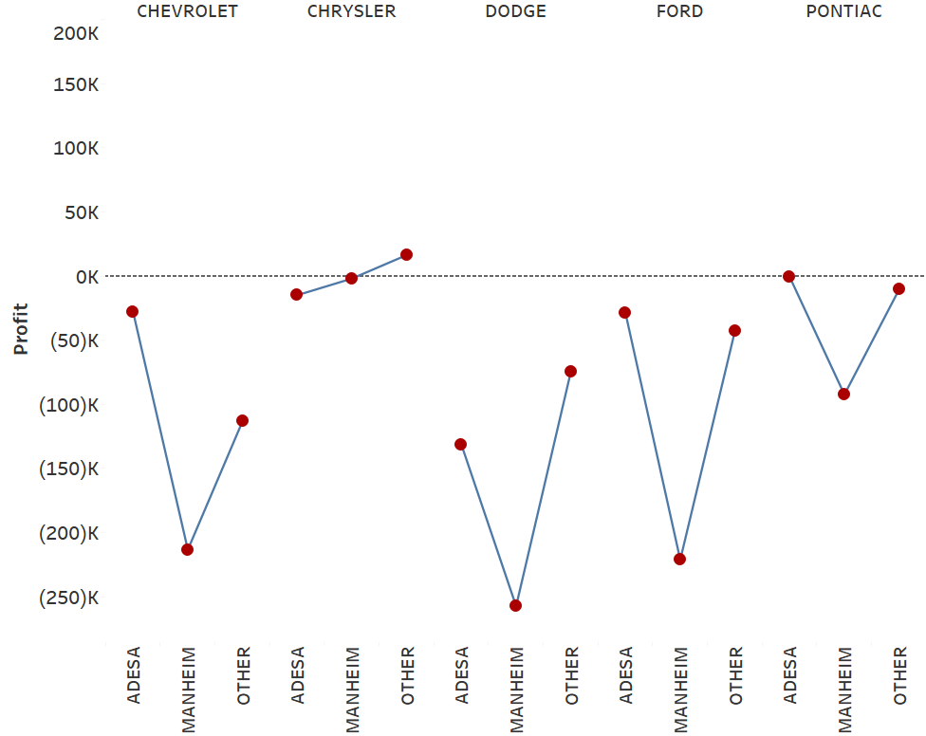
Auction Providers(UNFAVOURABLE Budget MARGIN)
BottomLine - The highest drop in Actual Profits comes through MANHEIM for TOP 5 MAKES by Sales

Slide 9
Conclusion
Carvana should understand the reasons for high budget variances
Change in market economy (High Competition)
Employee Fraud/Lack of expertise in auction bidding
High quality cars prioritized to generate more sales revenue
Notes:
Majority of cars are good when auction provider is MANHEIM. However, any increased cost incurred is not being Offset by Selling price
Most of the customers for CARVANA are middle income households which prefer quality cars at a modest price rather than purchasing TOP - end cars even though when the car is GOOD buy
CARVANA is not being able to bid competitively hence any increased competition in certain categories is driving down PROFITS. Eg - Dodge and Ford

